Slide 1
Project 3: Evaluation of telemarketing campaign on sales of long term deposits for a portuguese bank
E. Ito RA 159086
T. Nazatto RA 074388

Slide 2
CONTENTS
PROBLEM
OBJECTIVE
MACHINE LEARNING PROCESS
DECISION TREE
RESULTS
CONCLUSION
REFERENCES

Slide 3
PROBLEM
Is it possible to predict if a phone call from a marketing call center will succeed to sell a long term deposits plan by using machine learning approach on collected data with personnal customer atributes, approching information, and social economics of the momentum?
This is about a telemarketing campaign, realized between year 2008 to 2013, of a portuguese bank to capitalize more resources from customers by means of long term deposits for payment of interest rate, that competes with the reference index euribor3m, controlled by European Central Bank.
The dataset that we use, available in UCI [1] and Kaggle, contains data of customer approached by means of phone calls (cell phone or fixed telephone set) from marketing call center, contracted by the bank. The operator tries to convince the customer to accept the plan by explaning its advantages in a phone call with a certain duration, customer personnal data (age, education, job, etc) are registered, as well as it registered data of social economics of the momentum (number of employees, euribor3m rate, confidence rate index, etc), at the end of interview, it is registered the final outcome: accepted the plan or not.
We want to compare our outcomes with Moro el At., that originally studied this issue, and another two articles in internet , [3] and [4], that used the same dataset [1].

Slide 4
OBJECTIVE
Our objective is to evaluate if any prediction model fits on our proposed dataset during machine learning training phase, where the model is defined. As the dataset is composed by numerical and categorical feature, we will try Logistic Regression and Decision Tree Classifiers. We will test the model and make a qualitative analysis on more important features, and finally we compare the models with reference cases.
Our main hyphotesis is to verify if the attention given at inicial phase, at data preparation, improves the metrics and conclusions.
We intend to use SMOTE (Synthetic Minority Over-Sampling Technique) to apply to imbalanced datasets between negative and positive cases, dummy variables for categorical features, normalization.
For the metrics, we will use classification_report after confusion matrix to obtain accuracy, precision, recall and f1-score.
For qualitative analysis (A.Q.), we intend to use feature importance, RFE (Recursive Feature Elimination), and basic statistics (medium, standard deviation, quantification, t-test).

Slide 5
MACHINE LEARNING PROCESS
Ordem de Split do dataset (%)
TREINAMENTO DOS DADOS
TESTE DO MODELO
Extração dos Dados
Seleção das Features
Visualização de Dados
Preparação dos Dados
CRV
Teste do modelo
OK
Normalização dos Dados
OK
Matriz de Confusão
Análise Qualitativa
Obtenção do Modelo
Normalização de Dados
Matriz de Confusão
Tomada de decisão
Tomada de decisão
FIM
SMOTE
NOK
NOK
Re-treinar os dados
Re-treinar os dados

Slide 6
DECISION TREE

Slide 7
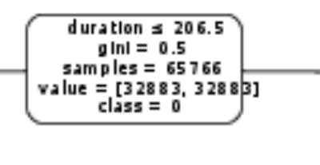
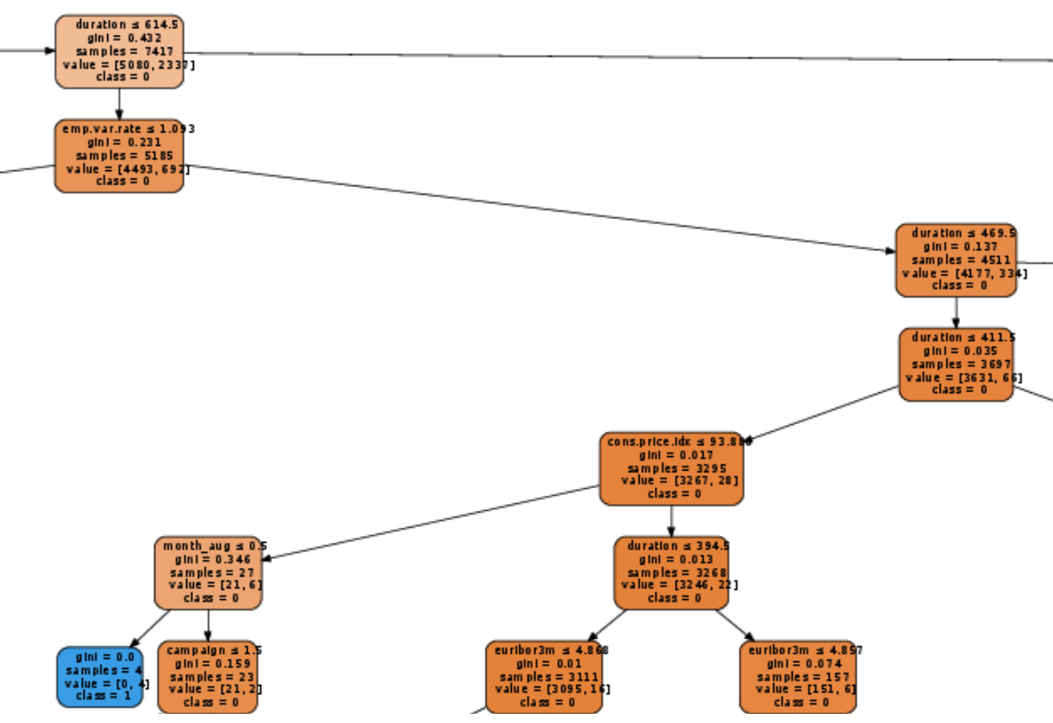
Decision Tree: Root, Decision Nodes and Leafs

Slide 8
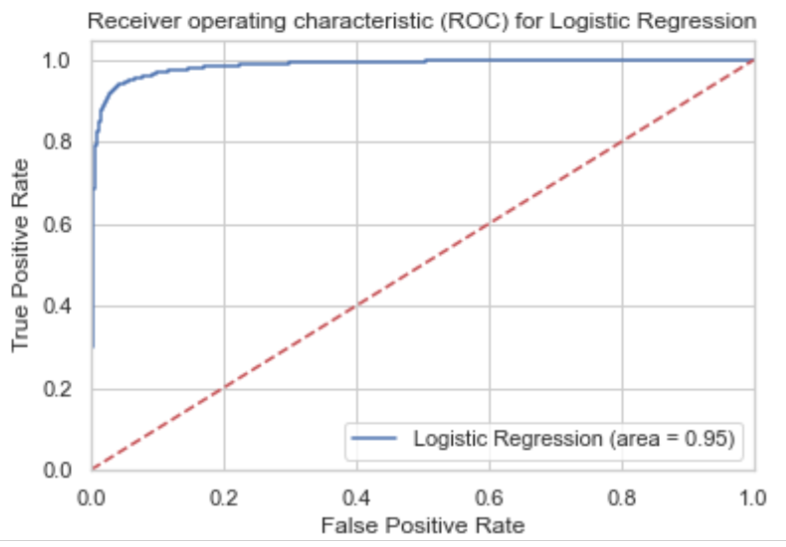
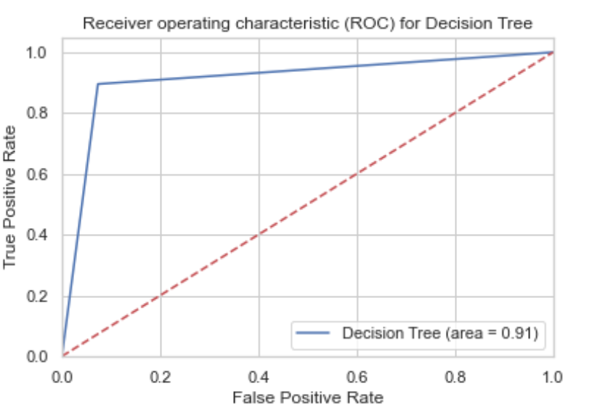
ROC GRAPHICS COMPARASION BETWEEN LR AND DT

Slide 9
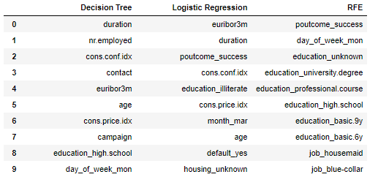
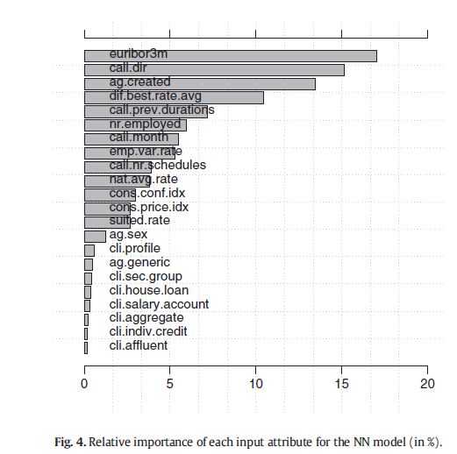
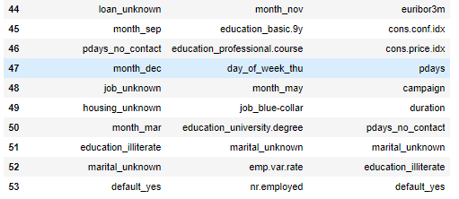
TABLE 1: 10 FEATURES MORE IMPORTANT
Relative feature importance acc. Moro et Al. [2]
TABLE 2: 10 FEATURES LESS IMPORTANT

Slide 10
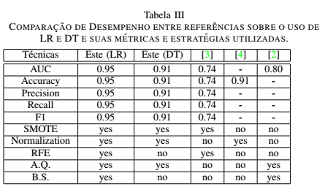
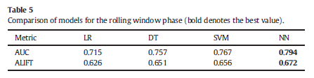
RESULTS
Moro et Al. [2]

Slide 11
CONCLUSION
The data preparation at training phase is important for better quality of metrics. Techniques as SMOTE, feature selection, normalization help to adjust the model to dataset, and quality of metrics is better.
Decision Tree classifier has the better performance in the classification of numerical and categorical features. RFE penalizes the numerical features, and Logistic Regression not penalizes the features less significant.
Moro et Al. [2] used sensibility analysis obtained the following more important features: euribor3m, call duration and as customers are approached (campaign, contact). We obtained almost the same conclusions, using DT feature importance, with addicional features in the context social-economics as number of employees, consumer confidence index, consumer price index. And social atributes as age (40 years in average), education, and more promissing day of week (monday).
In case of dataset containing numerical and categorical features, the only use of Decision Tree would be recommendable. Not need to use Logistic Regression nor RFE for feature importance.

Slide 12
